Slide 1
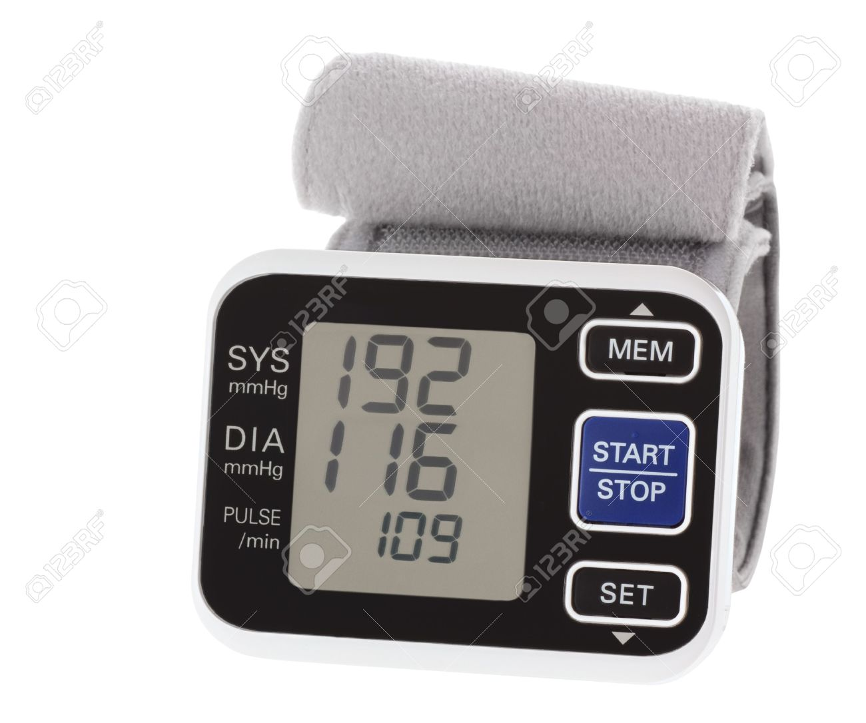
University of Basrah
College of Nursing
Fundamentals of Nursing Department
First Stage
Vital Signs (Theory)
Pulse & Blood pressure
Lecture 3
University of Basrah –College of Nursing – Fundamentals of Nursing Department

Slide 2
Vital Signs
Vital signs are a person’s temperature, pulse, respiration, and blood pressure.
Pain, often included as the fifth vital sign.
The health status of a person is reflected in these indicators of body functions, regulated through homeostatic mechanisms, and falling within certain normal ranges. A change in vital signs might indicate a change in health.
University of Basrah –College of Nursing– Fundamentals of Nursing Department
2

Slide 3
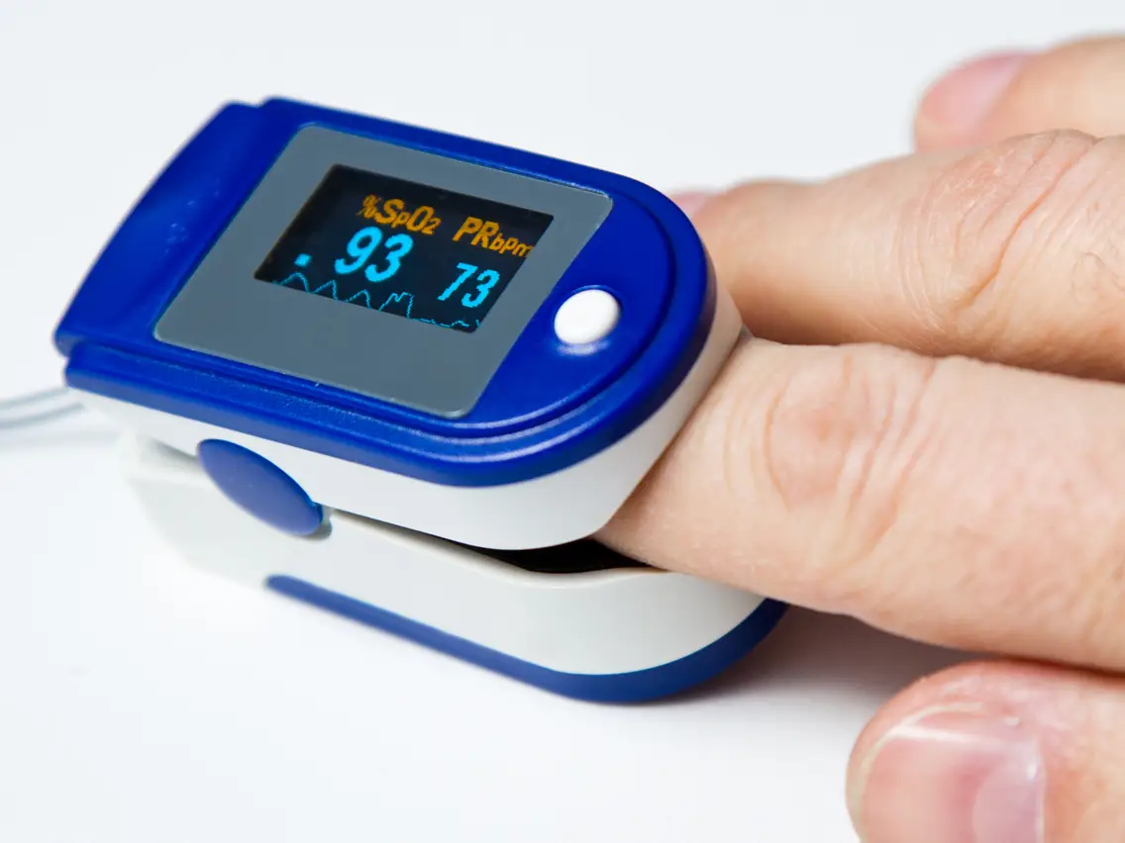
Vital Signs
Pulse oximetry, the noninvasive measurement of arterial oxyhemoglobin saturation, is also often included with the measurement of vital signs in hospitalized patients.
Pulse oximetry
University of Basrah –College of Nursing– Fundamentals of Nursing Department
2

Slide 4
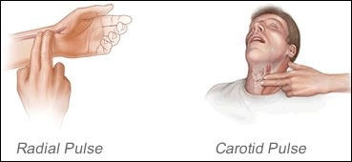
Pulse
Pulse is a throbbing sensation that can be palpated over a peripheral artery, such as the radial artery or the carotid artery.
University of Basrah –College of Nursing– Fundamentals of Nursing Department
3

Slide 6
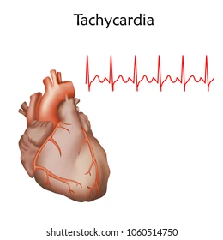
Tachycardia, a rapid heart rate (100- 180 beats/min).
decreases cardiac filling time, which, in turn, decreases stroke volume and cardiac output.
University of Basrah –College of Nursing– Fundamentals of Nursing Department
9

Slide 7
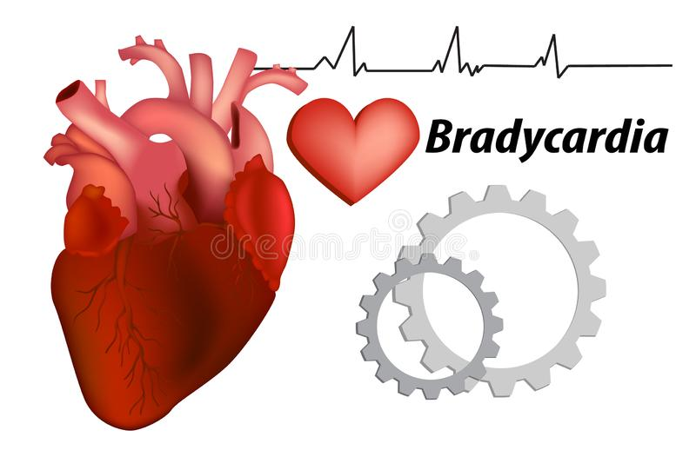
Bradycardia: is a pulse rate below (60 beats/min)
The pulse rate is normally slower during sleep in men and in people who are thin, hypothermia as metabolic processes decrease, and with aging.
University of Basrah –College of Nursing– Fundamentals of Nursing Department
9

Slide 8
Cardiac output, Stroke Volume, and heart rate
Cardiac output (Co.): Is the amount of blood your heart pumps each minute. ** Normally (5-6 liters) each minute at rest.
Stroke volume (SV.): The amount of blood your heart pumps each time it beats.
Heart rate (HR.): The number of times your heart beats per minute.
( cardiac output= stroke volume* heart rate)
For example: 65 mL * 70 beats per minute = 4.55 L per minute.
University of Basrah –College of Nursing– Fundamentals of Nursing Department
4

Slide 9
peripheral pulse
Peripheral pulses: are palpable when left ventricle contracts and ejected blood into the vascular system.
Characteristics of the peripheral pulse, including :
Rate.
Quality (strong or weak).
Rhythm (regular or irregular).
volume of blood ejected with each heartbeat (stroke volume).
University of Basrah –College of Nursing– Fundamentals of Nursing Department
5

Slide 10
Factors Affecting the Pulse rate
Age: Pulse rate decreases as a person ages due to decreased metabolic rate.
Gender: Women on average have slightly higher pulse rates than men.
physical activity: The pulse rate increases with exercise. However, well conditioned athletes may have a significantly decreased pulse rate. This is due to greater efficiency and strength of the heart muscle from regular cardiovascular exercise.
University of Basrah –College of Nursing– Fundamentals of Nursing Department
6

Slide 11
Factors Affecting the Pulse rate
4. Fever: An elevated body temperature causes increased pulse rate due to increased metabolic demands and compensatory mechanisms to increase heat loss.
5. Stress: Increased levels of stress cause an increased pulse rate. Such as pain, fear, and anxiety.
6. Disease: Such as pneumonia, sepsis.
7. Medications: Some medications increase a patient’s pulse rate and others decrease a patient’s pulse rate.
University of Basrah –College of Nursing– Fundamentals of Nursing Department
6

Slide 12
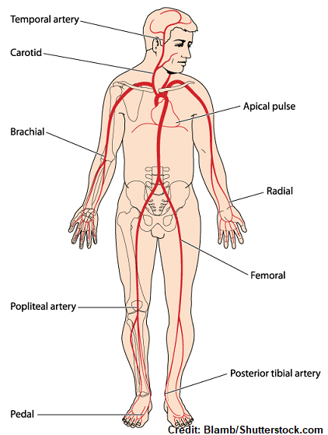
Pulse Sites
Temporal .
Carotid.
Apical.
Brachial.
Radial.
Ulnar .
Femoral.
Popliteal.
Posterior tibial.
Dorsalis pedis.
University of Basrah –College of Nursing– Fundamentals of Nursing Department
10

Slide 13
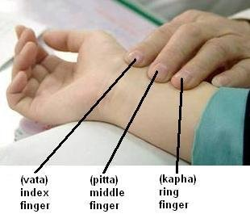
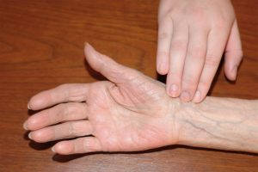
Assessing the Pulse
A pulse is commonly assessed by palpation (feeling) or auscultation (hearing). applying moderate pressure with the three middle fingertips of the hand.
A stethoscope is used for assessing apical pulse
University of Basrah –College of Nursing– Fundamentals of Nursing Department
11

Slide 14
Nursing Considerations Before Assessing Pulse rate
Any medication that could affect the heart rate.
Any physically activity. If so, wait (10-15 minutes).
3. Any baseline data about the normal heart rate for the client. For example, a physically fit athlete may have a resting heart rate below 60 beats/min.
4. In some clients, the rate changes with the position because of changes in blood flow volume and autonomic nervous system activity.
University of Basrah –College of Nursing– Fundamentals of Nursing Department
12

Slide 15
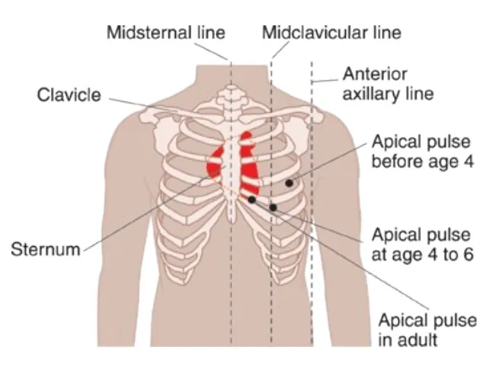
Assessing The Apical Pulse
The contraction of the heart can be heard in the space between the fifth and the sixth ribs, about 8 cm (3 inches) to the left of the median line and slightly below the nipple.
Apical pulse measurement is also the preferred method of pulse assessment for infants and children less than 2 years of age .
University of Basrah –College of Nursing– Fundamentals of Nursing Department
13

Slide 16
University of Basrah –College of Nursing– Fundamentals of Nursing Department
14

Slide 17
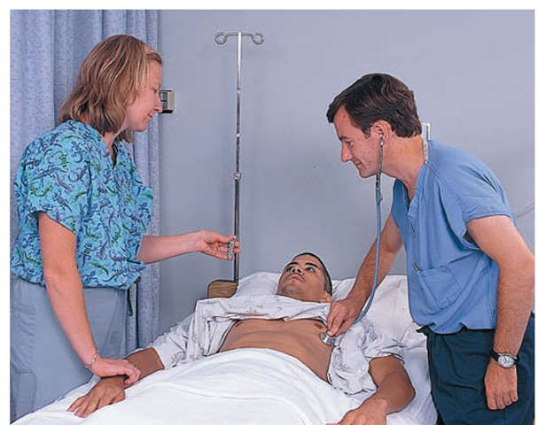
Assessing The Apical-radial Pulse
A difference between the apical and radial pulse rates is called the pulse deficit and indicates that all of the heartbeats are not reaching the peripheral arteries or are too weak to be palpated.
University of Basrah –College of Nursing– Fundamentals of Nursing Department
15

Slide 18
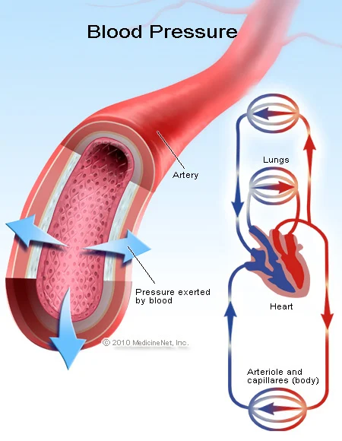
Blood Pressure
Blood pressure refers to the force of the moving blood against arterial walls.
Maximum blood pressure is exerted on the walls of arteries when the left ventricle of the heart contracts and pushes blood through the aortic valve into the aorta at the beginning of systole.
Blood pressure is measured in millimeters of mercury (mm Hg)
University of Basrah –College of Nursing– Fundamentals of Nursing Department
16

Slide 19
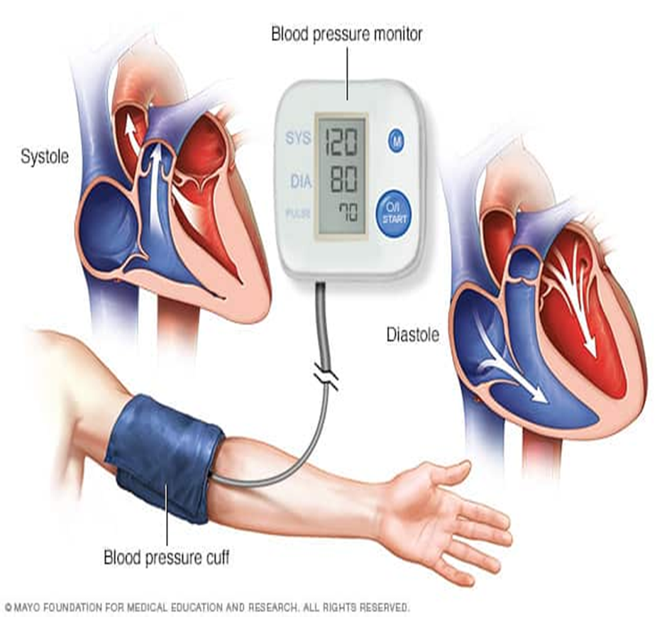
The highest pressure, created during ventricular contraction, is the systolic pressure.
When the heart rests between beats during ventricular diastole, the pressure drops. The lowest pressure present on arterial walls at this time is the diastolic pressure.
The difference between the systolic and diastolic pressures is called the pulse pressure.
University of Basrah –College of Nursing– Fundamentals of Nursing Department
17

Slide 20
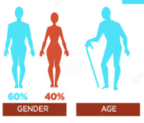
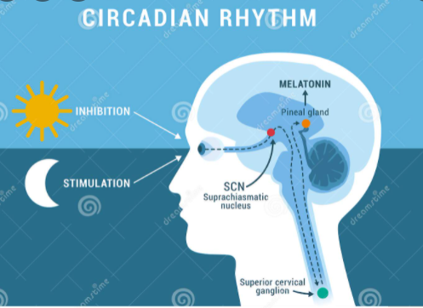
Age:
Circadian rhythm
GenderFood intake:
Exercise:
Factors Affecting Blood Pressure
Age: The older adult has decrease the elasticity of the arteries, which increase peripheral resistance and therefore increase blood pressure.
2. Gender: Women usually have lower blood pressure than men of the same age until menopause.
3. Circadian rhythm: Normal fluctuations occur during the day. The blood pressure is usually lowest on arising in the morning. Blood pressure has been noted to rise as much as (5- 10 mmHg) by late afternoon , and gradually falls again during sleep.
University of Basrah –College of Nursing– Fundamentals of Nursing Department
18

Slide 21
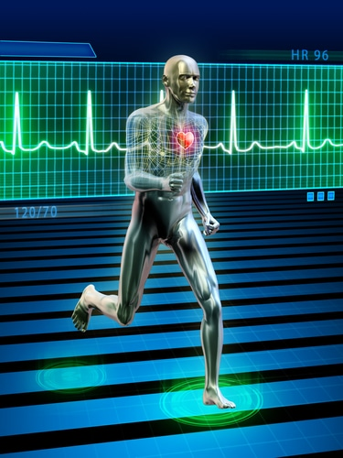
Age:
Circadian rhythm
GenderFood intake:
Exercise:
Factors Affecting Blood Pressure
4. Exercise : Systolic blood pressure rises during period of exercise and strenuous activity.
5. Weight: Blood pressure is usually higher in people who are obese than in those who are thin.
University of Basrah –College of Nursing– Fundamentals of Nursing Department
18

Slide 22
6. Food intake: Blood pressure increases after eating food.
7. Emotional status: Such as anger , fear and pain, generally causes blood pressure to rise , but the pressure falls to normal when the situation passes.
8. Body position: Blood pressure tends to be lower in a prone or supine position than when sitting or standing.
9.Race: Is a factor increase blood pressure , which is more prevalent and more sever in African American men and women.
10. Medications : Oral contraceptive cause a mild increase in blood pressure in many women.

Slide 23
Categories For Blood Pressure Levels
Blood Pressure Classifications | Systolic BP | Diastolic BP
Normal | <120 mmHg | <80 mmHg
Prehypertension | 120–139 mmHg | 80-89 mmHg
High blood pressure
Stage 1 | 140-159 mmHg | 90-99 mmHg
Stage 2 | ≥ 160 mmHg | ≥ 100 mmHg
University of Basrah –College of Nursing– Fundamentals of Nursing Department
20

Slide 24
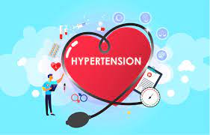
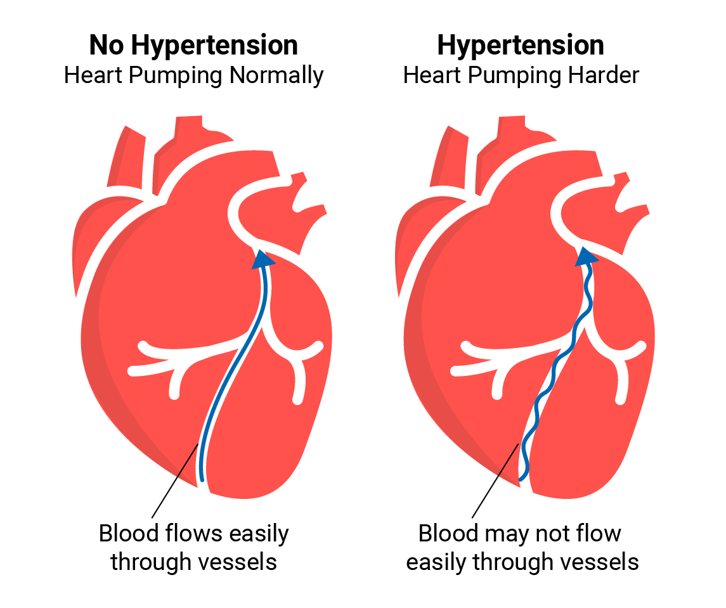
Hypertension is made when the systolic pressure is 140 mm Hg or higher or the diastolic pressure is 90 mm Hg or higher.
University of Basrah –College of Nursing– Fundamentals of Nursing Department
21

Slide 25
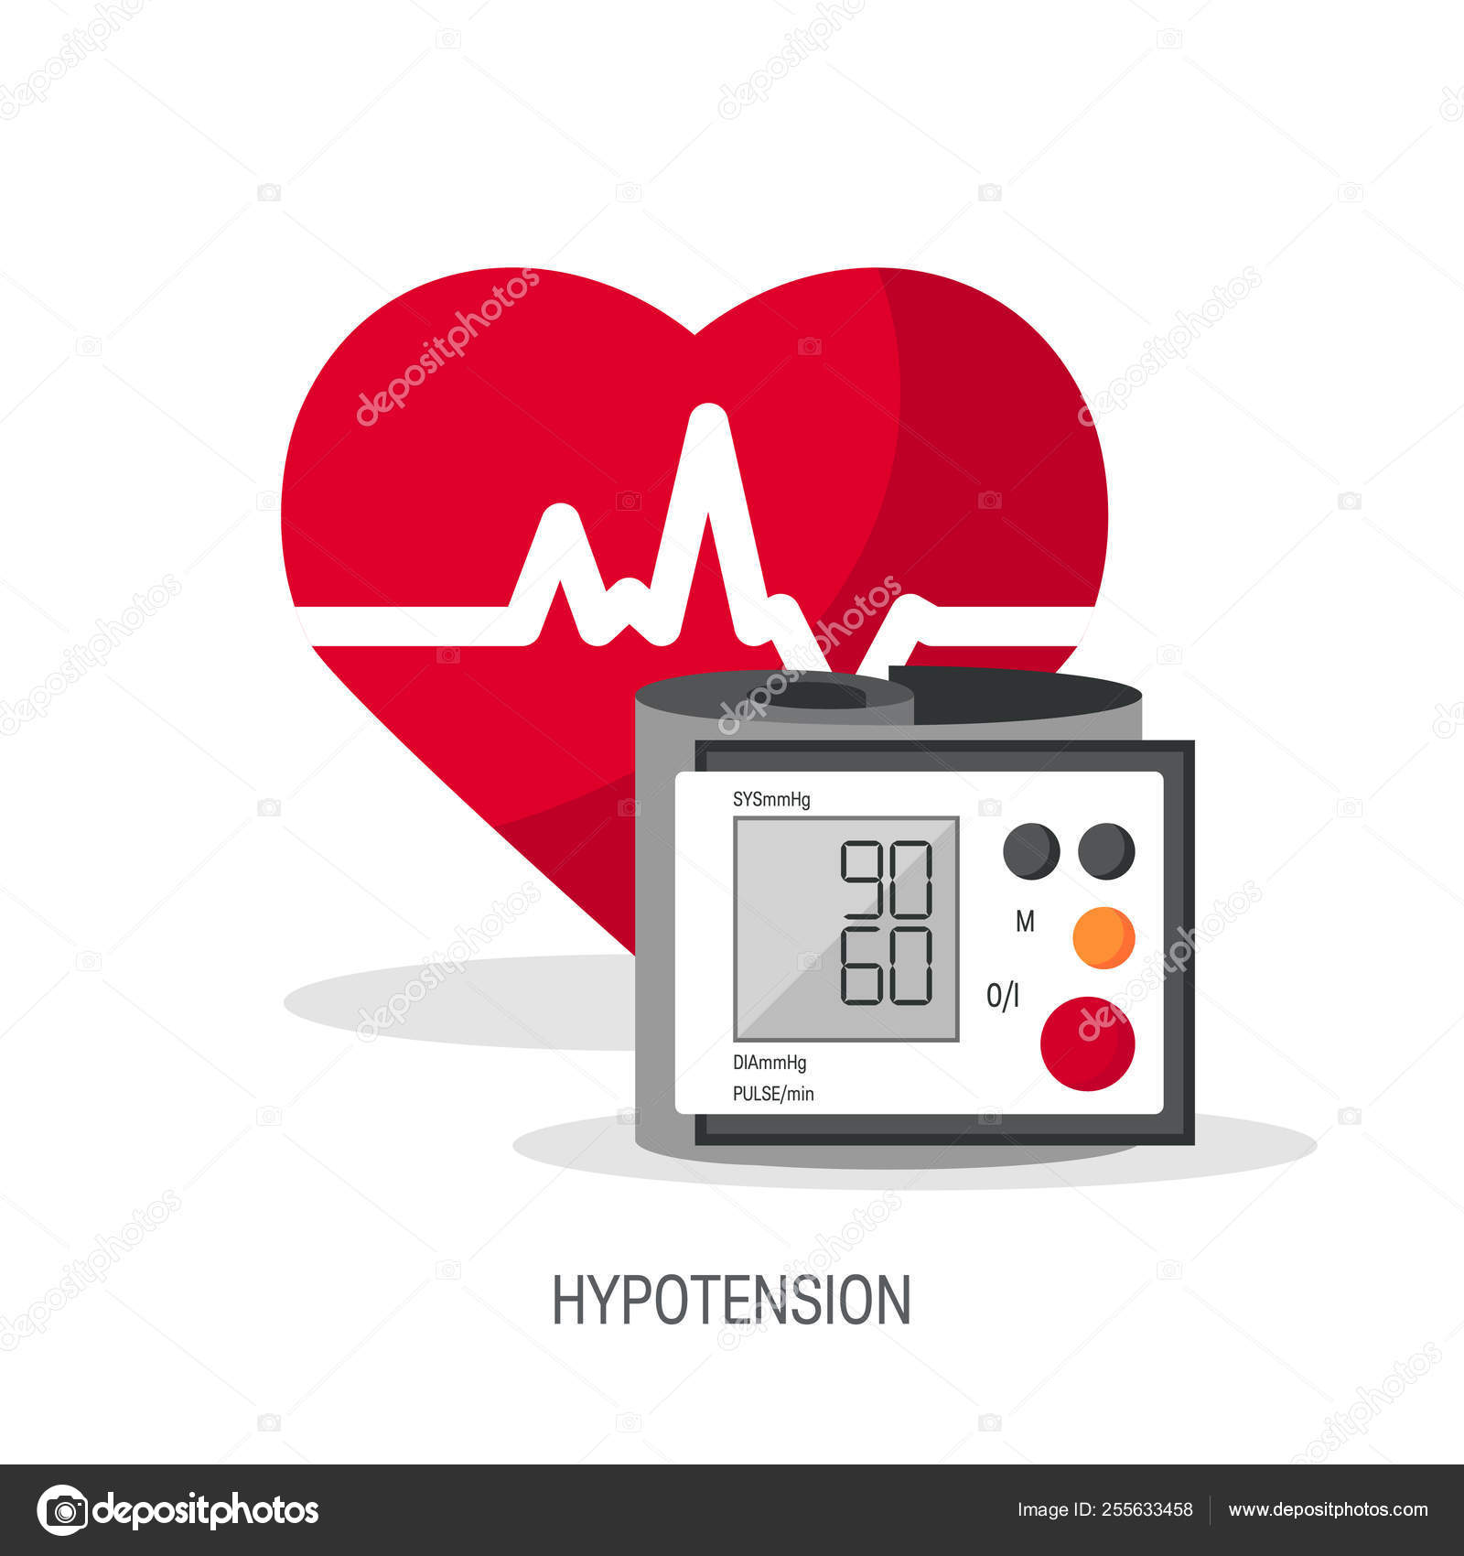
Hypotension is below-normal blood pressure. A consistently low blood pressure (e.g., a systolic reading of 90–115 mm Hg).
University of Basrah –College of Nursing– Fundamentals of Nursing Department
21

Slide 26
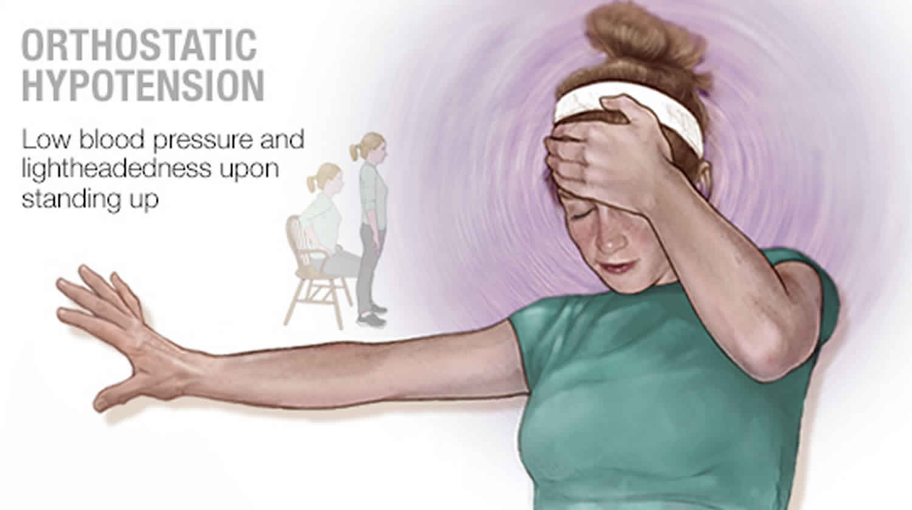
Orthostatic hypotension (postural hypotension) is a decrease in systolic blood pressure of 20 mm Hg or a decrease in diastolic blood pressure of 10 mm Hg within 3 minutes of standing when compared with blood pressure from the sitting or supine position.
University of Basrah –College of Nursing– Fundamentals of Nursing Department
21

Slide 27
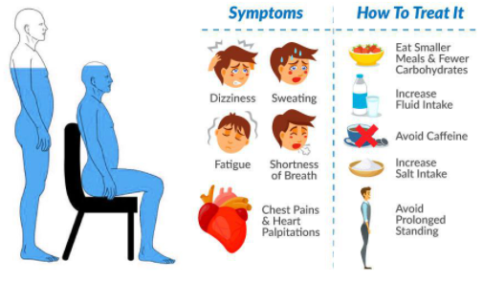
Symptoms of Orthostatic hypotension (postural hypotension)
**** Orthostatic hypotension may be acute or chronic, as well as symptomatic or asymptomatic .
It is associated with:
Dizziness .
Lightheadedness.
Blurred vision.
Weakness .
Fatigue.
Nausea.
Palpitations.
Headache.
University of Basrah –College of Nursing– Fundamentals of Nursing Department
22

Slide 28
23

